Slide 1
CS315 Software Engineering

Slide 2
Agenda
Course Objectives
Course Books
Course Content
Course Evaluation

Slide 3
Course Objectives
Survey software engineering concepts, terminology and techniques.
Emphasis on Agile Design Methods.
Some practical programming concepts (Design Patterns).
Notes:
Design patterns to common programming problem.

Slide 4
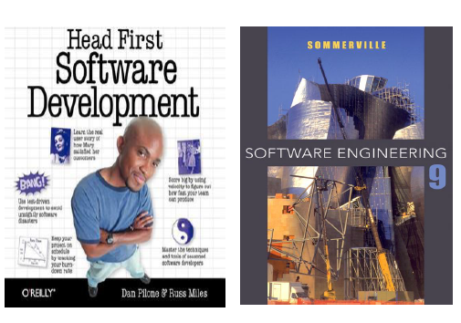
Course Books

Slide 5
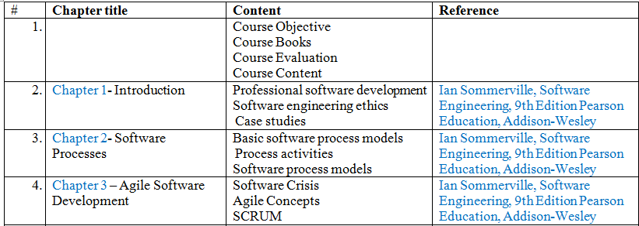
Course Content

Slide 6
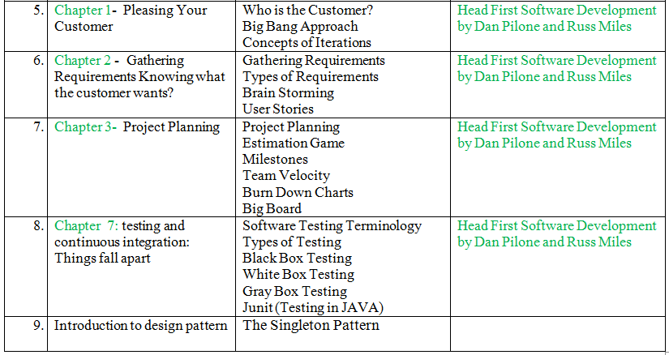
Course Content

Slide 7
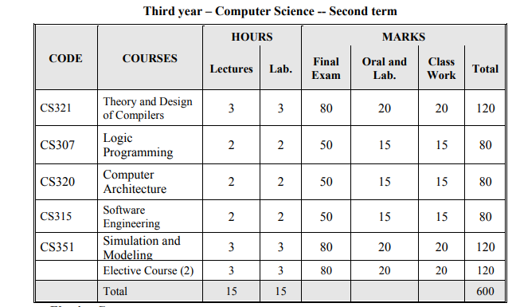
Course Evaluation

